Slide 1

APPLICATIONS OF DATA SCIENCE: Appreciating Letters from Grandma Kelly Jones | June 2018
Notes:
0:00 My name is Kelly Jones and I’m here today to tell you about my grandmother. Grandma Jones was my first and best pen pal, but she’d been writing letters since long before I came along. Since she passed away three years ago, I’ve had a box of letters in my apartment that she wrote in the past, and now I am finally putting that box to good use. Those letters are my dataset, and I used natural language processing methods, or NLP, to find out what was most important to her and what her life was like.

Slide 2
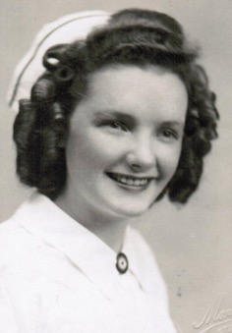
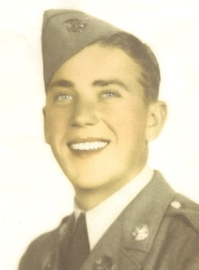


65 years
30+ moves
Elizabeth “Betty” Jones
1923 – 2015
Frank “Mutt” Jones
1919 – 2012
Notes:
0:30 First, a quick introduction. My grandparents—Betty and Mutt, as they were known—were married for 65 years. Grandma was a nurse and Grandpa was in the Air Force, and thanks to that, they moved more than 30 times… most of those during the first half of their marriage while their family grew to five kids.

Slide 3
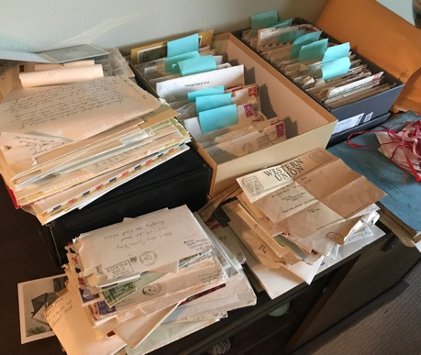
Dataset
365 letters from 1941 to 1970
89% written to her parents
38 locations postmarked
Notes:
When I unpacked the box of letters, I found that there was a lot there. In total, there were 365 letters that my Grandmother had written, the vast majority of those to her parents. There were also 38 different locations postmarked. So my first instinct with this dataset was to map it.

Slide 4

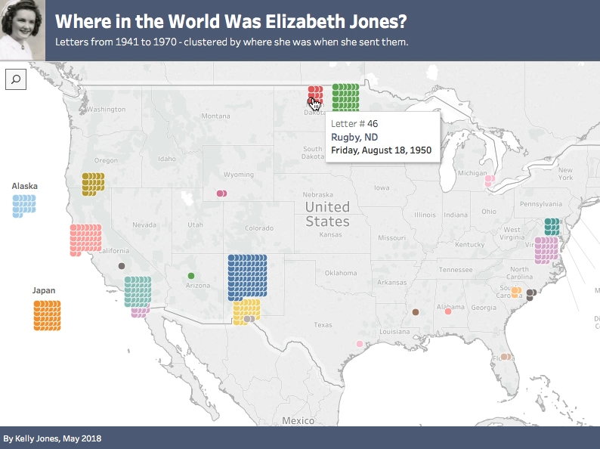
Notes:
1:00 These are the locations from which Grandma Jones sent her 362 letters, starting with her hometown of Rugby, North Dakota. Each dot is one letter, jittered around a point where they lived, and you can hover over dots to see the dates. This map shows you where a lot of the US air bases are.

Slide 5
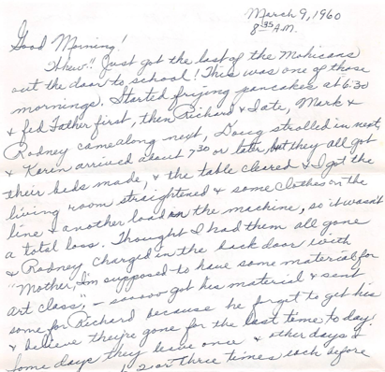
Challenges
Problem: Machines struggle with cursive
1. Optical Character Recognition
2. Dictation
3. Transcription (171 letters)
52 myself
12 family
107 Amazon MTurk
Notes:
There were a few challenges with this dataset. The first was digitizing the content of the letters. Cursive is a little bit hard for humans to read, but it is a LOT hard for machines. I started by scanning in some letters and running them through Optical Character Recognition software. The output was gibberish. One program returned a full page of Arabic. My next idea was to read the letters aloud into a dictation program, but I found that there were too many errors and it was inefficient to go back and correct them. The fastest way ended up being transcription, getting people who can type quickly to type up the letters. I transcribed more than 50 myself, got a dozen more done by family members, and got another 107 from Amazon Mechanical Turk, which is an online marketplace for human intelligence tasks like this. Using MTurk was fascinating and, in fact, a few of my Turkers are watching this livestream tonight! In total, I have transcribed about half of the dataset, or 170 letters.
The second challenge with the dataset was that humor doesn’t always translate, so when my grandmother was 8 months pregnant with twins she called “Pete” and “Don’t Repeat”, that doesn’t get captured by the analysis.

Slide 6




NLP Results
n-grams
Sentiment
Recommender
Unigrams:
Words about family
Bigrams:
“Good morning!”
Polarity: Almost all positive
tf-idf: Greatest cosine similarity
Notes:
Here are some of the results of my analysis. First, I used the Natural Language Toolkit, or NLTK, in Python and looked at n-grams, which are the most common words or sequences of words.

Slide 7
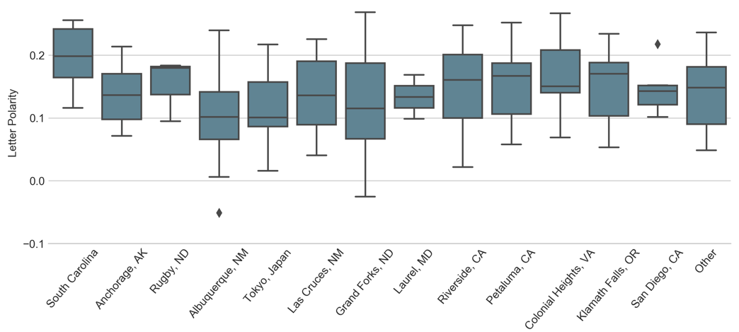
Sentiment Analysis
1946
1970
Notes:
Here are all the places she lived, in chronological order. All letters but two had positive sentiment. Widest range of sentiments in Grand Forks, ND in 1959-61 as her kids reached adolescence

Slide 8
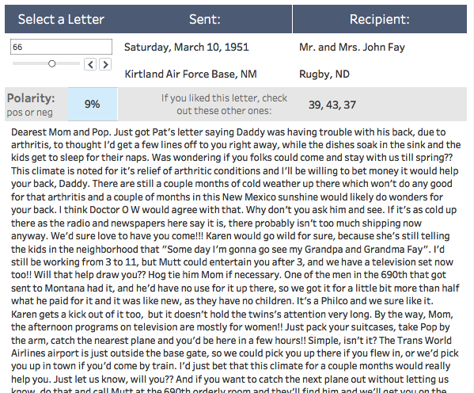
Letter Explorer
Tableau
Recommender
tf-idf
Notes:
2:45
In this case, the end customer of my product was my family, so I wanted to give them a way to explore these letters, including offering suggestions on which letters they may want to read next

Slide 9

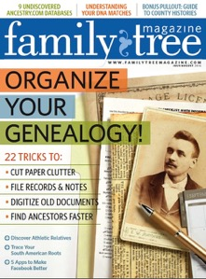


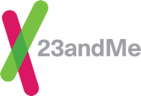


Applications

Slide 10
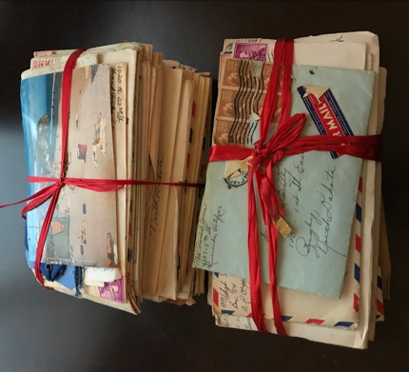
Next Steps
Complete the Dataset
Scan, transcribe, and analyze remaining 190 letters
Refine Topic Modeling
What topics did she discuss the most?
Personalized Recommender
Tailored to different family members
Notes:
3:00 Though these skills have a lot of business applications, the end user of this product is really my family.

Slide 11
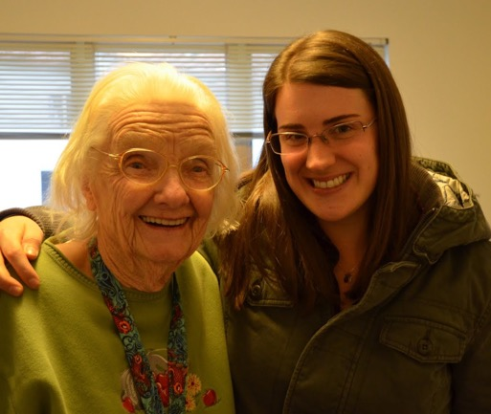
Thanks!
“It's some job to raise a family as big as yours is. Wonder if any of us will do nearly as well with our families as you have done with yours.”
Letter to her parents for their 31st anniversary June 3, 1952
Elizabeth Jones | Francis Jones | Project Files | Map and Recommender (Tableau) | Slide Template | Batch Geocode
Notes:
3:20 I’ll close with a quote that reminded me that the way we look at the generations ahead of us is just like how they looked at the generation ahead of them. This quote inspired me to continuing to build out this project and make meaning of the legacy she left behind. Thank you.

Slide 12
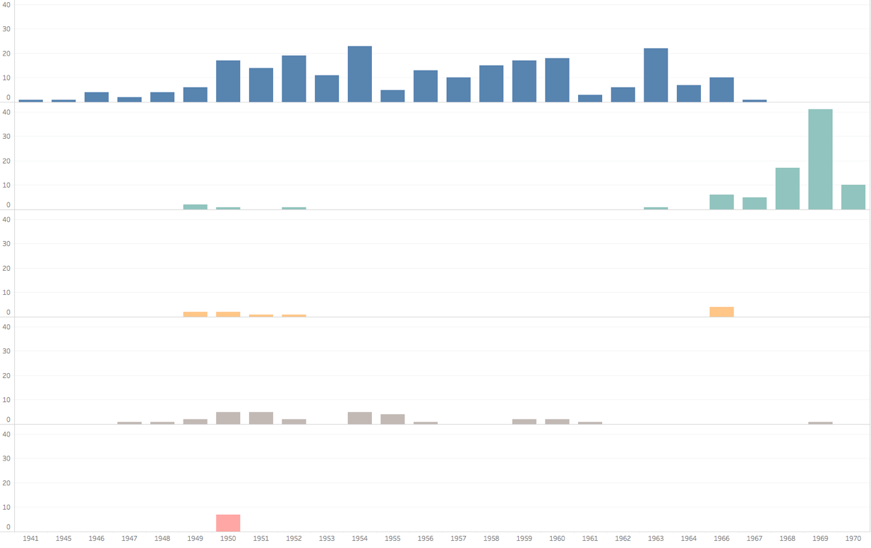
Parents
Mother
Father
Other Fam
Husband
Notes:
OVERFLOW SLIDE
After her father’s death in 1967, she wrote a lot more letters to her mother. That mirrored my own response to losing Grandpa Jones in 2012, which was to write weekly letters to Grandma until she passed in 2015. It touched me to see that we had the same instinct for how to comfort someone who was grieving, which was to be a constant presence and love them through it.

Slide 13
Humor Doesn’t Translate
“
“
While 7 months pregnant with Mark:
“Any objections if I take a couple days off while I’m home and increase our family?? If so, just say so and I’ll wait till next year to have ‘it’!”
While 8 months pregnant with twins Rodney and Richard:
“Pete & Don’t Repeat are battling as usual.”
Notes:
OVERFLOW SLIDE
Grandma was really funny, but NLP has a hard time discerning humor.

Slide 14


When Did She Write?
Looked at bigrams (word pairs) in opening line
“Good morning”
“Good afternoon”
“Good evening”
62 times
4 times
0 times
Notes:
OVERFLOW SLIDE
How did letter-writing fit into her life?

Slide 15
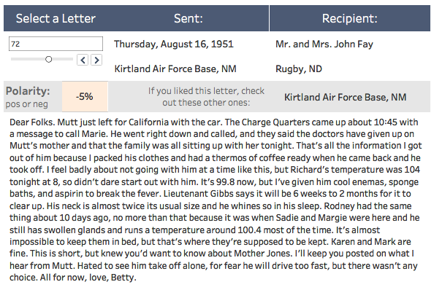
Notes:
OVERFLOW SLIDE
The most negative letter

